Slide 1
Mysteries of the Music City Marathon… Revealed!
GOLD MEDAL TEAM
Media Elmas
Lori Butler
Benjamin Shuler
John Borthick

Slide 2
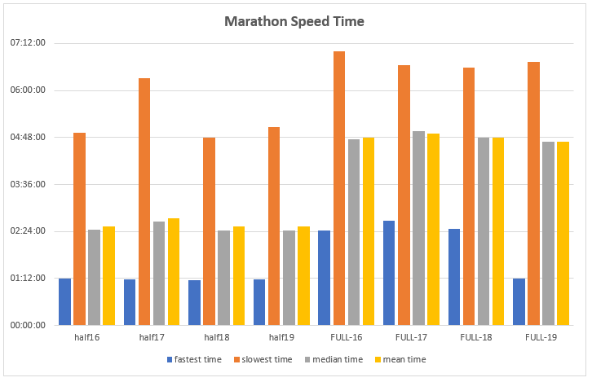

Slide 3
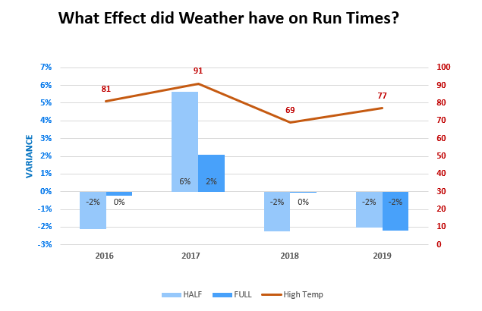

Slide 4
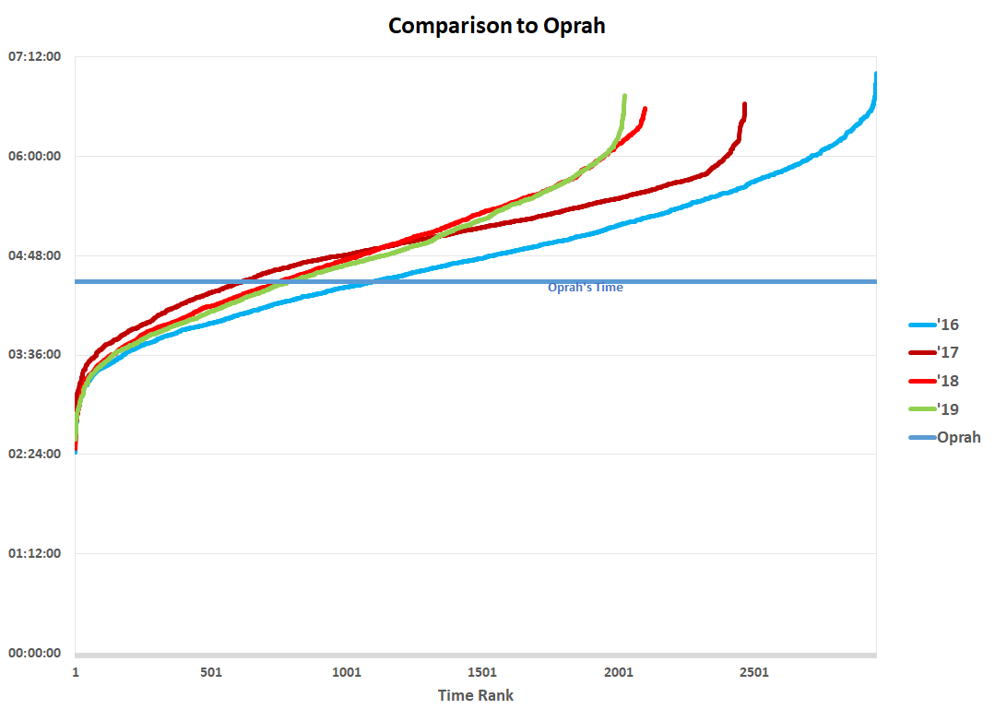

Slide 5
